Slide 1
A CLOUD BROKERAGE ARCHITECTURE FOR EFFICIENT CLOUD SERVICE SELECTION

Slide 2

A CLOUD BROKERAGE ARCHITECTURE FOR EFFICIENT CLOUD SERVICE SELECTION
B BALAJI
G UMESH CHANDRA
S GNANADEEP
G KRISHNA SAI
(209E1A0515) (209E1A0561) (209E1A0565) (219E5A0504)
BATCH No : 06
UNDER THE ESTEEMED GUIDANCE OF
Dr. K.SANTHI, PhD
DEPARTMENT OF COMPUTER SCIENCE AND ENGINEERING
SRI VENKATESWARA ENGINEERING COLLEGE
Karakambadi Road, Opp. LIC Training Center, Tirupati-517507

Slide 3
INDEX
Abstract
Introduction
Existing Method
Disadvantages
Proposed method
Advantages
Block Diagram
System Specifications
Architecture
UML Diagrams
Result
Conclusion

Slide 4
ABSTRACT
The rapid expansion of cloud computing services presents consumers with abundant options but also introduces the challenge of selecting the optimal service amidst the vast array of choices. To address this, our paper proposes a groundbreaking brokerage-based architecture in the cloud. In this model, cloud brokers take on the responsibility of service selection. We introduce an efficient information management structure, the Bcloud-tree, designed for handling data from numerous cloud service providers. Our developed service selection algorithm recommends the most suitable cloud services to consumers. Through extensive real and synthetic cloud data experiments, we showcase a notable performance improvement compared to existing methods. Key terms include cloud computing, cloud brokerage, service selection, Bcloud-tree, indexing, and querying.

Slide 5
INTRODUCTION
Cloud computing has revolutionized the landscape of IT services, offering businesses unparalleled flexibility and scalability in accessing computing resources and storage space. This shift has been particularly beneficial for small and medium-sized enterprises (SMEs), allowing them to access capabilities previously out of reach. However, as the number of cloud providers and services continues to proliferate, the task of selecting the most suitable cloud services becomes increasingly daunting.
To address this challenge, cloud brokerage mechanisms have emerged to assist cloud consumers in discovering, mediating, and monitoring cloud services effectively. These mechanisms play a crucial role in aiding cloud users in selecting appropriate services that align with their specific requirements. While existing research has primarily focused on identifying relevant selection criteria and methodologies for evaluating these criteria, the sheer volume of available cloud providers and services presents a new hurdle in the selection process.

Slide 6
LITERATURE SURVEY
S. NO | Journal Type with year | Authors | Title | Outcomes
1 | Science China Information Sciences, 2012 | P. Li, H. Sun, B. Sheng and J. Shen | Image stylization with enhanced structure on GPU | This paper presents a graphics processing unit (GPU) based stylization approach that preserves the fine structure between the original and the stylized images using gradient optimization
2 | IEEE, 2018 | B. Sheng, P. Li, Y. Jin, P. Tan and T. Lee | Intrinsic image decomposition with step and drift shading separation | Our approach is physics based and learning free and leads to more accurate and robust reflectance decompositions

Slide 7
EXISTING METHOD
The existing system for cloud service selection lacks efficiency and faces challenges in managing the vast array of dynamic cloud service information. The absence of a dedicated brokerage architecture results in time-consuming manual efforts from consumers to collect and analyse data from numerous providers. There is no specialized indexing structure, leading to difficulties in organizing and updating service information. Queries from consumers are not effectively grouped, impacting the overall responsiveness. Additionally, the current system lacks a comprehensive algorithm for handling diverse service selection queries. Performance evaluations reveal limitations when compared to the proposed Bcloud-tree-based approach, emphasizing the need for improvement in the existing system.

Slide 8
ADVENTAGES:
The proposed cloud service selection approach offers several advantages over the existing system:
1. Efficiency: The generic cloud brokerage architecture streamlines the selection process, reducing the time and effort required by consumers to find suitable services.
2. Organization: The Bcloud-tree indexing structure efficiently stores and manages a large volume of dynamic cloud service information, providing a structured and organized system for data.
3. Query Flexibility: The query algorithm supports a wide range of service selection queries, allowing users to specify diverse requirements, such as intervals of desired values for multiple properties.
4. User-Friendly: By grouping similar queries and employing a powerful query engine, the system enhances user experience, making it more intuitive and responsive.
5. Real-World Validation: The approach is validated through studies involving real cloud providers, demonstrating its effectiveness and performance improvement over the existing method.
6. Automation: The cloud broker takes on the responsibility of service selection, automating the process for consumers and relieving them from the burden of manually analyzing and comparing services.

Slide 9
PROPOSED METHOD
We propose a streamlined cloud service selection process through generic brokerage architecture for this we are using the AES algorithm for the security and privacy to protect the data. The cloud broker receives consumers' requirements, groups similar queries, and utilizes a powerful query engine to search the Bcloud-tree for matching services. Our contributions include the Bcloud-tree, proficient in storing and indexing dynamic cloud service data, an effective query algorithm for diverse service selection queries, and demonstrated performance improvements over existing methods through real scenario-based evaluations of cloud providers.

Slide 10
DISADVANTAGES
The disadvantages of the existing system include:
1. Manual and Time-Consuming Selection: Consumers face the burden of manually collecting and analysing information from multiple cloud service providers, leading to a time-consuming selection process.
2. Lack of Specialized Architecture: The absence of a dedicated brokerage-based architecture results in inefficiencies in service selection and management.
3. Inefficient Data Organization: Without a specialized indexing structure, there are challenges in efficiently organizing and updating the large volume of dynamic cloud service information.
4. Poor Query Responsiveness: The existing system struggles with effectively grouping and responding to consumers' queries, impacting the overall responsiveness of the service selection process.
5. Limited Query Handling: The system lacks a comprehensive algorithm for handling diverse service selection queries, hindering its ability to accommodate various user requirements.
6. Performance Limitations: Comparative evaluations indicate performance limitations when compared to the proposed Bcloud-tree-based approach, highlighting the need for enhancements in the existing system.

Slide 11
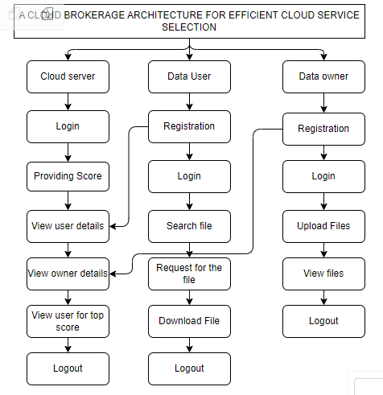
BLOCK DIAGRAM

Slide 12
SYSTEM SPECIFICATIONS
H/W CONFIGURATION:
• Processor - I3/Intel Processor
• Hard Disk -160GB
• Key Board - Standard Windows Keyboard
• Mouse - Two or Three Button Mouse
• Monitor - SVGA
• RAM - 4Gb
S/W CONFIGURATION:
• Operating System : Windows 7/8/10
• Server side Script : Python, HTML, MYSQL, CSS, Bootstrap.
• Libraries : PANDAS, Flask, Smtlib
• IDE : PyCharm
• Technology : Python 3.6+

Slide 13
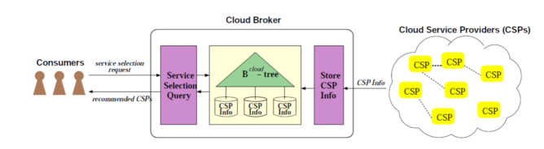
ARCHITECTURE
AES (Advanced Encryption Standard), established by NIST in 2001, is a widely used encryption algorithm due to its strength and efficiency. Operating on 128-bit blocks, it employs substitution, permutation, and XOR operations in rounds, with key schedules based on key length, offering robust security for electronic data.

Slide 14
UML DIAGRAMS
USE CASE DIAGRAM:
A use case diagram in the Unified Modeling Language (UML) is a type of behavioral diagram defined by and created from a Use-case analysis. Its purpose is to present a graphical overview of the functionality provided by a system in terms of actors, their goals (represented as use cases), and any dependencies between those use cases. The main purpose of a use case diagram is to show what system functions are performed for which actor. Roles of the actors in the system can be depicted.

Slide 15
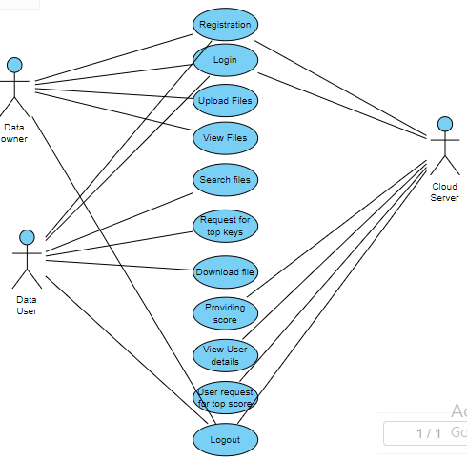

Slide 16
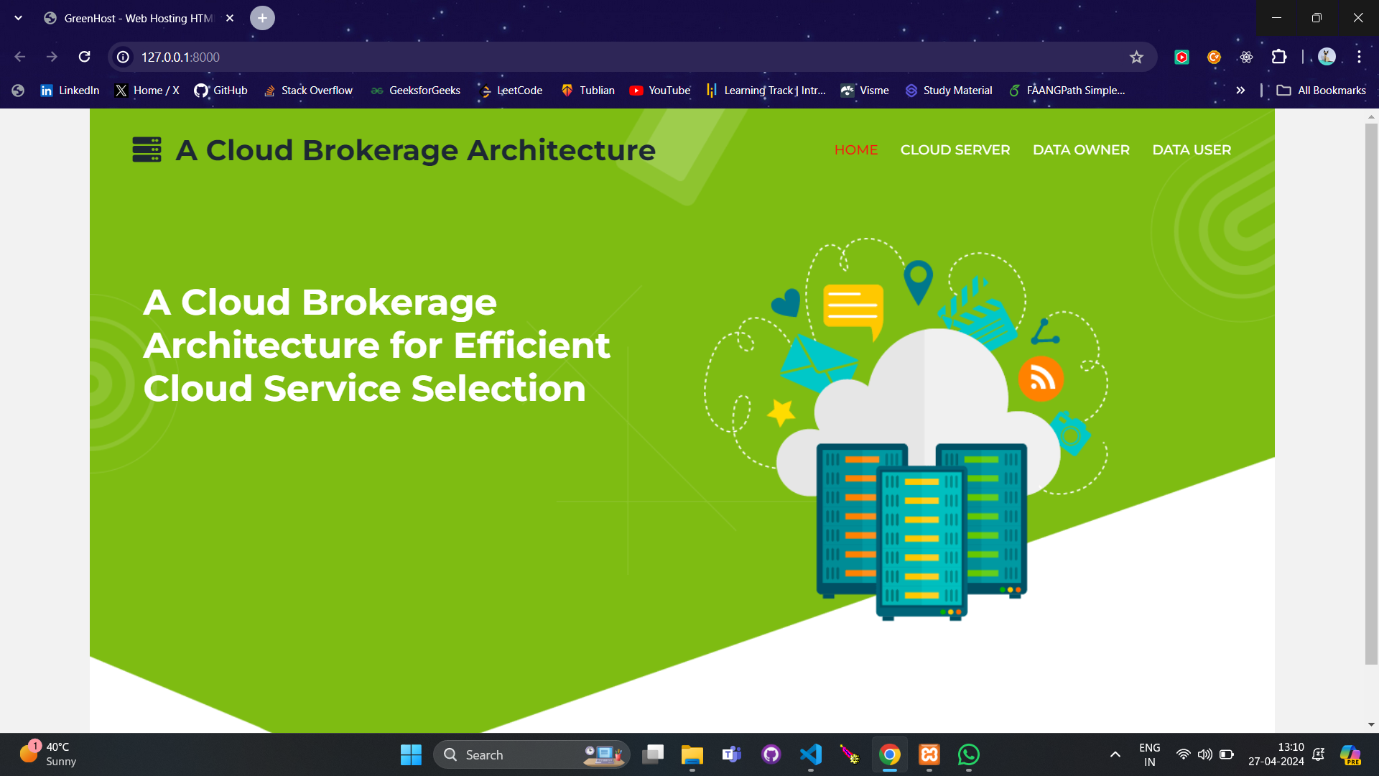
RESULTS
Home Pages:

Slide 17
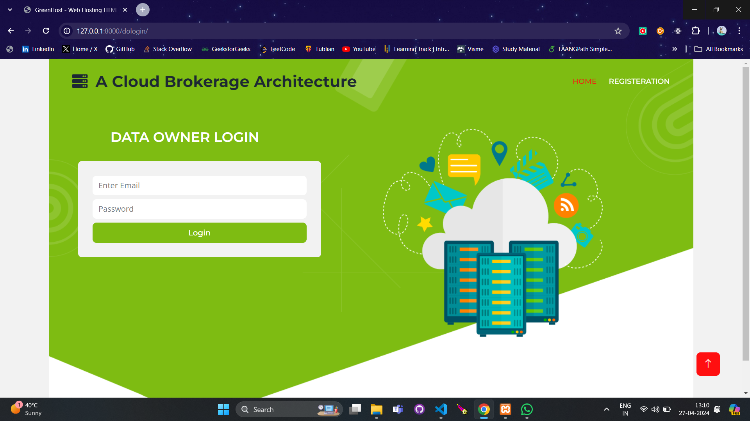
Data Owner Login:

Slide 18
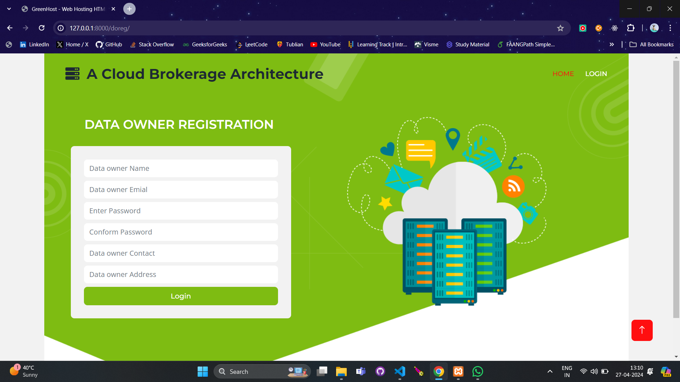
Data Owner Registration:

Slide 19

User Login:

Slide 20
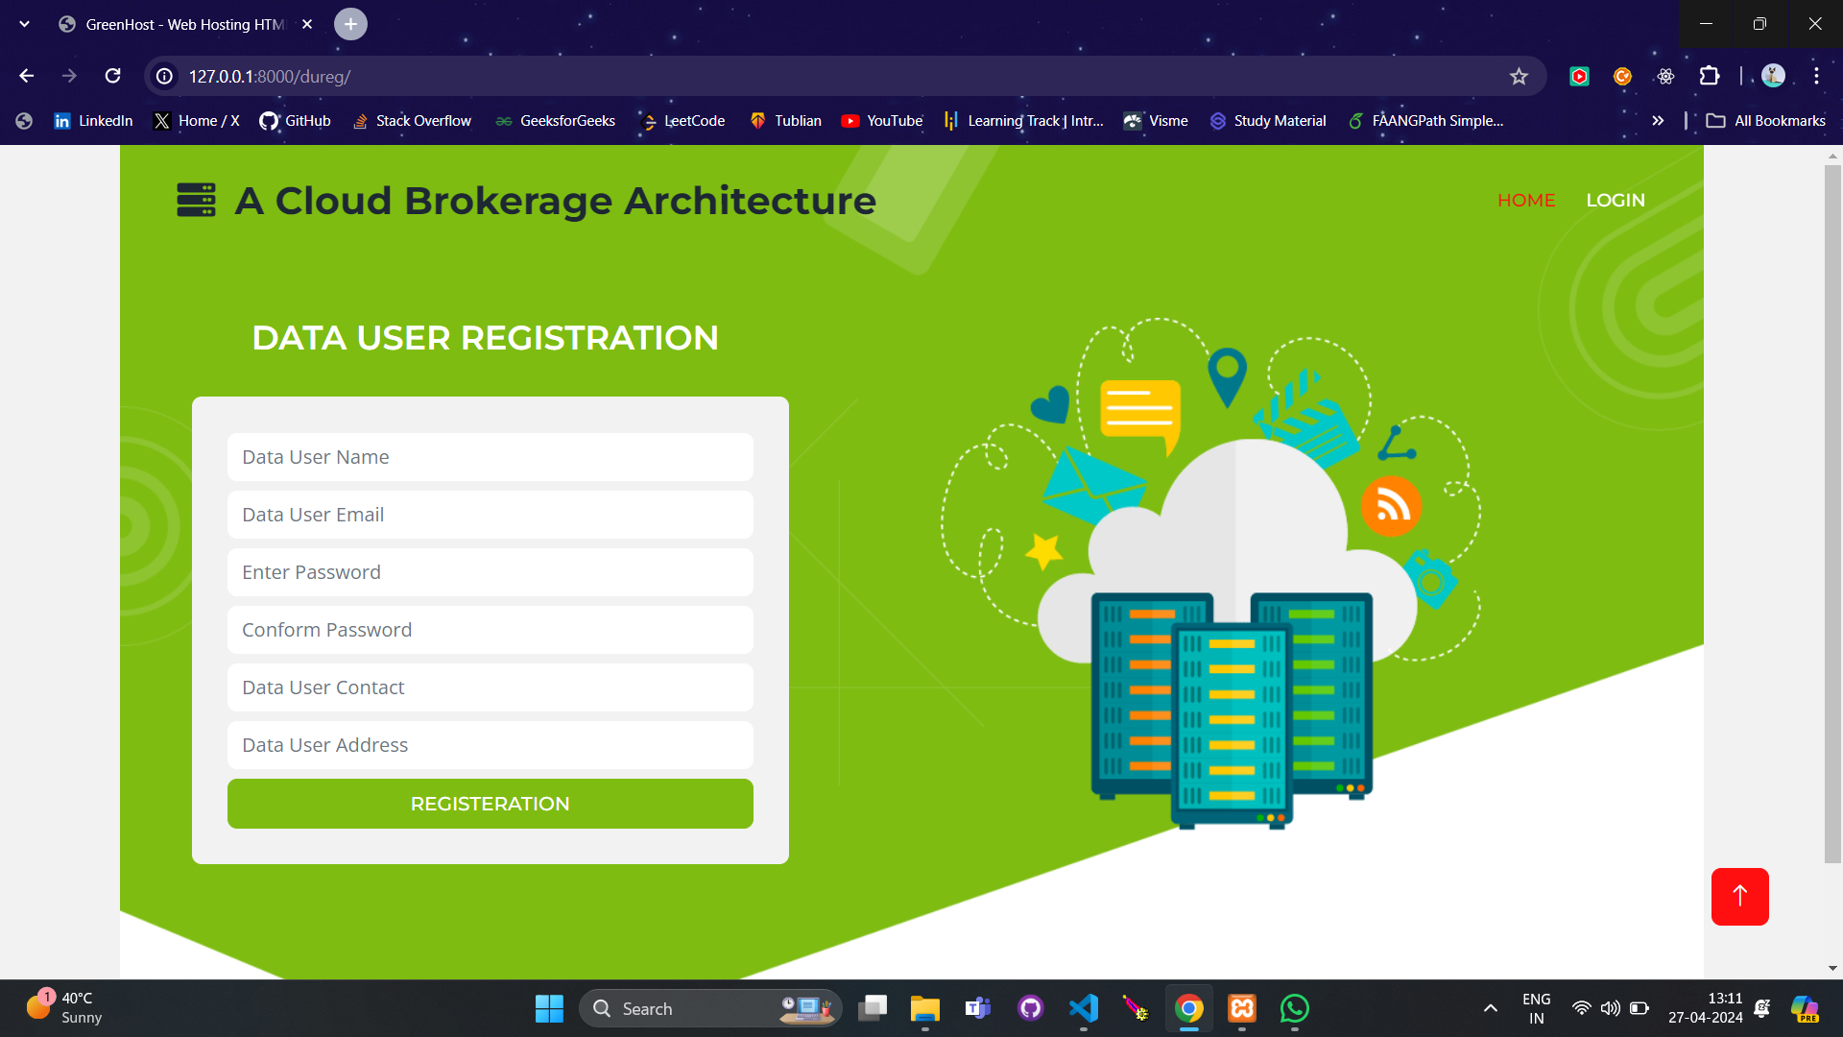
Data User Registration:

Slide 21
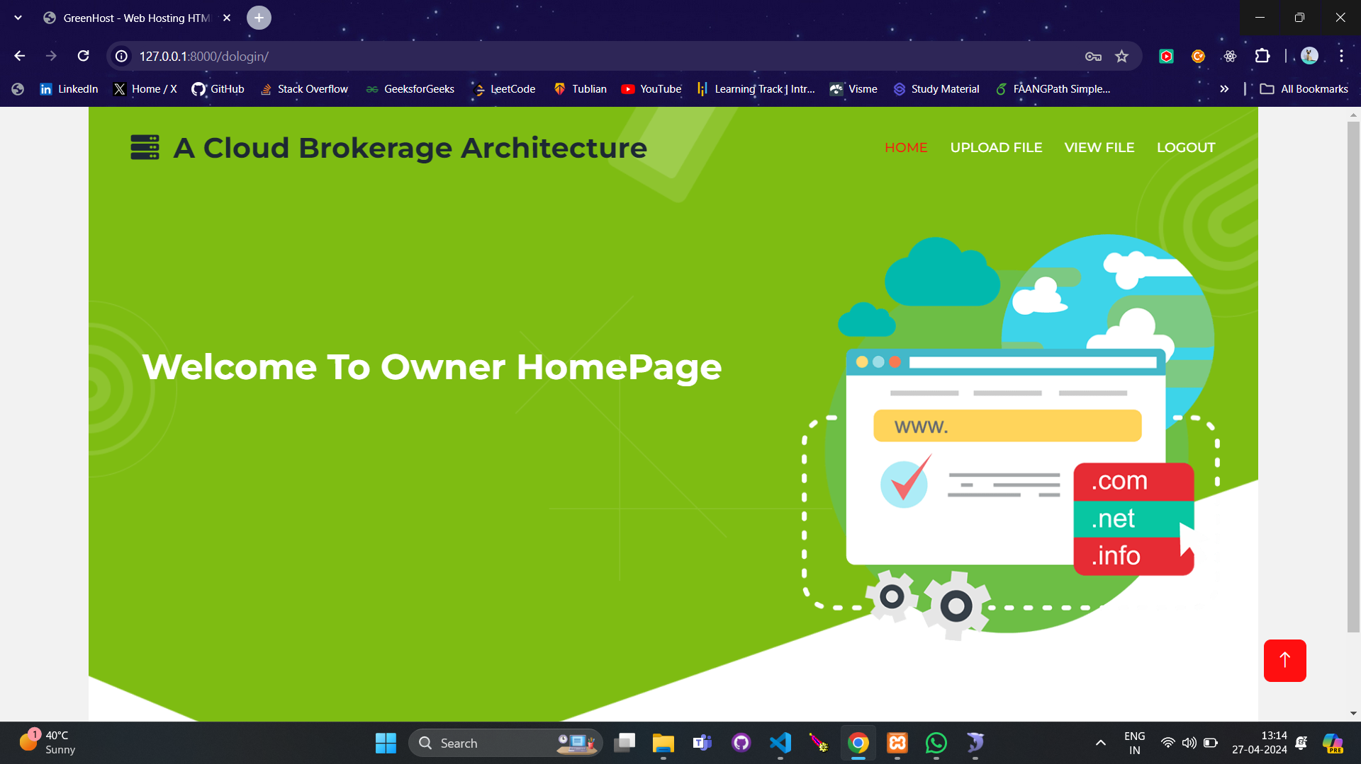
Data Owner Home Page:

Slide 22
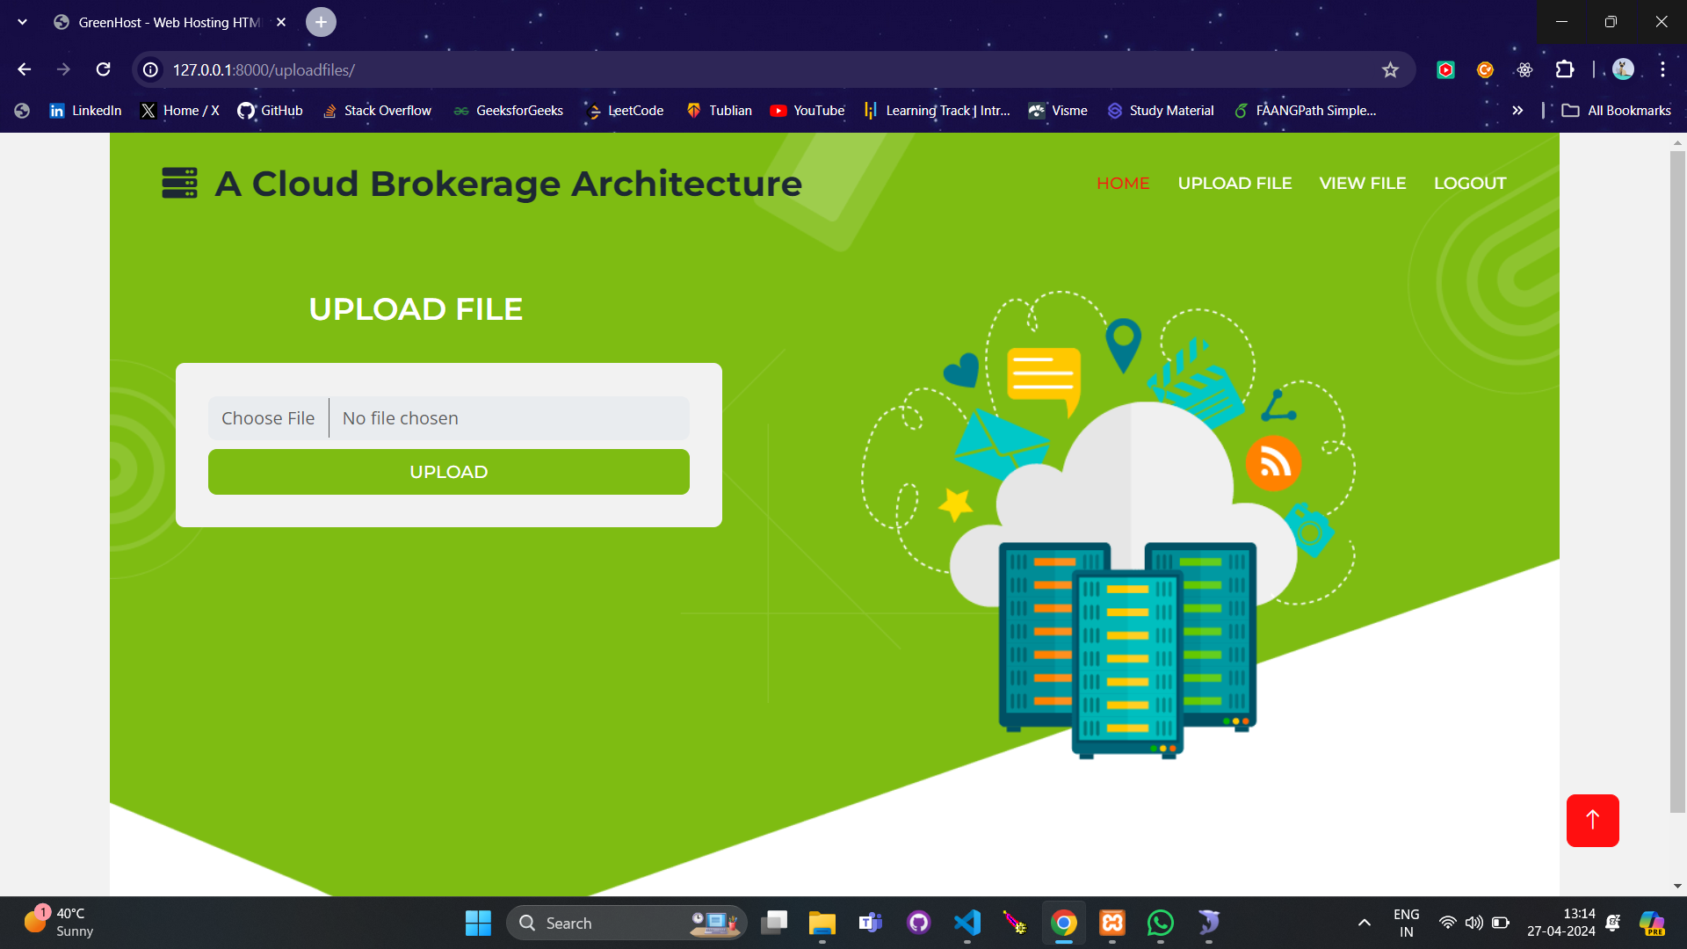
Uploading Files: Upon logging in as a data owner, navigate to the 'Upload files' option and proceed to upload your files.

Slide 23
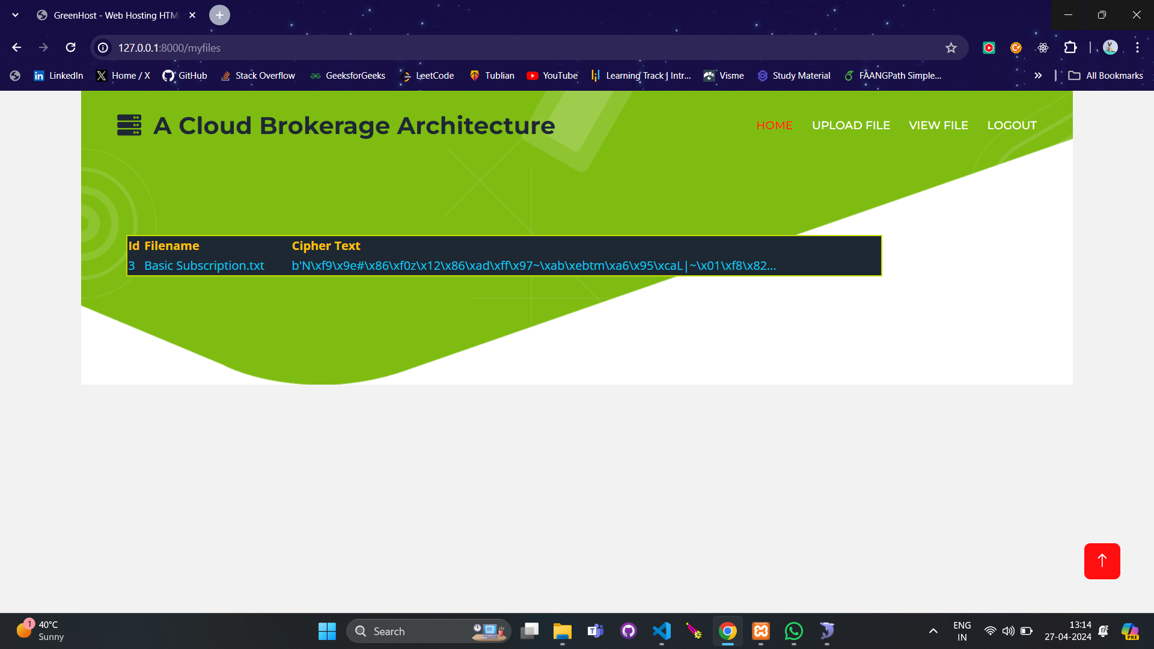
Viewing Uploaded Files: As a data owner, access the 'View files' option to review the files you have uploaded.

Slide 24

CSP Login:

Slide 25
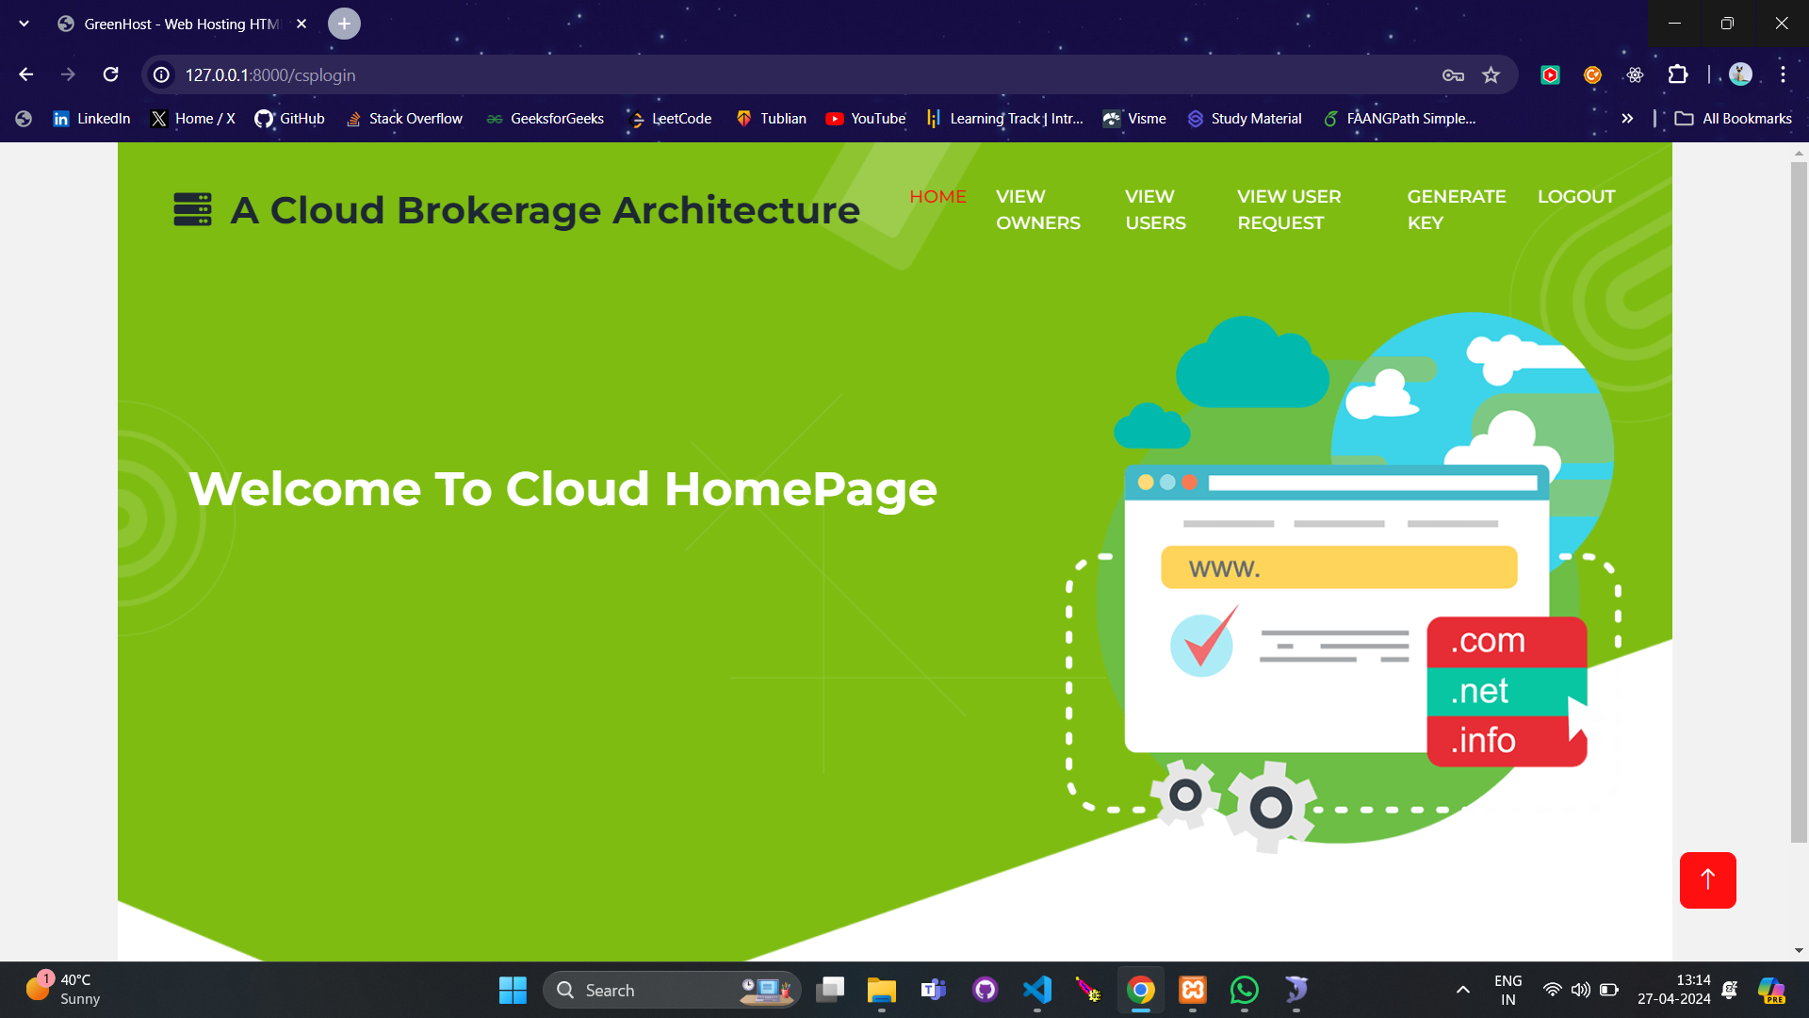
CSP Home Page:

Slide 26
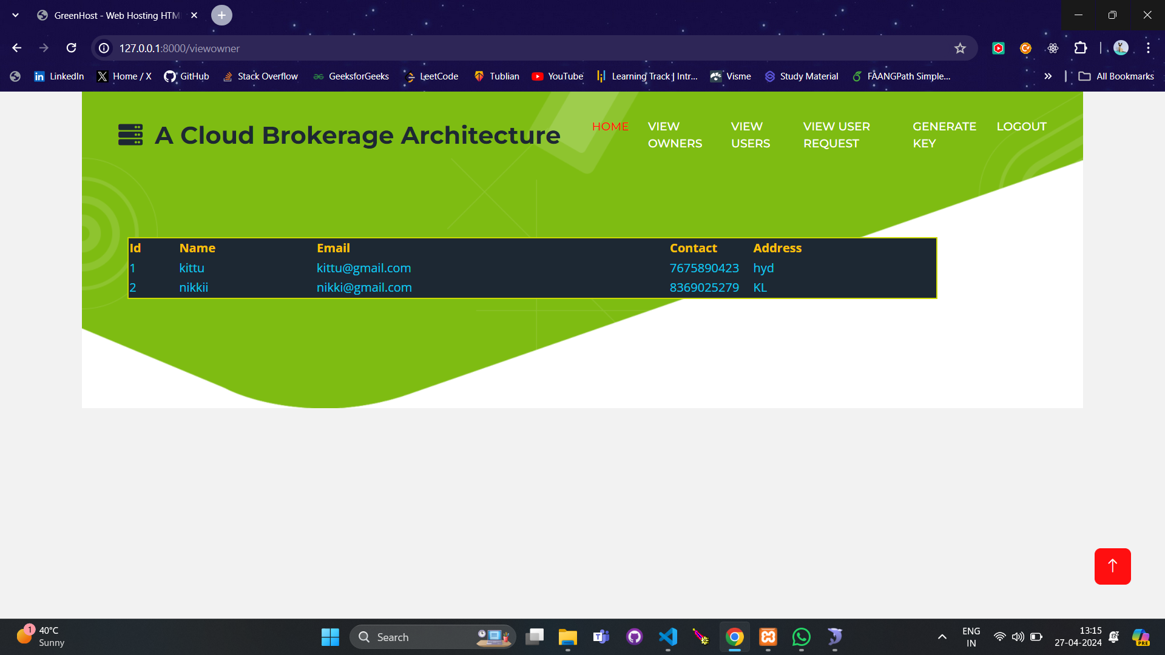
Viewing Data Owners: Access the 'View owners' option to see a list of data owners registered within the cloud service platform.

Slide 27
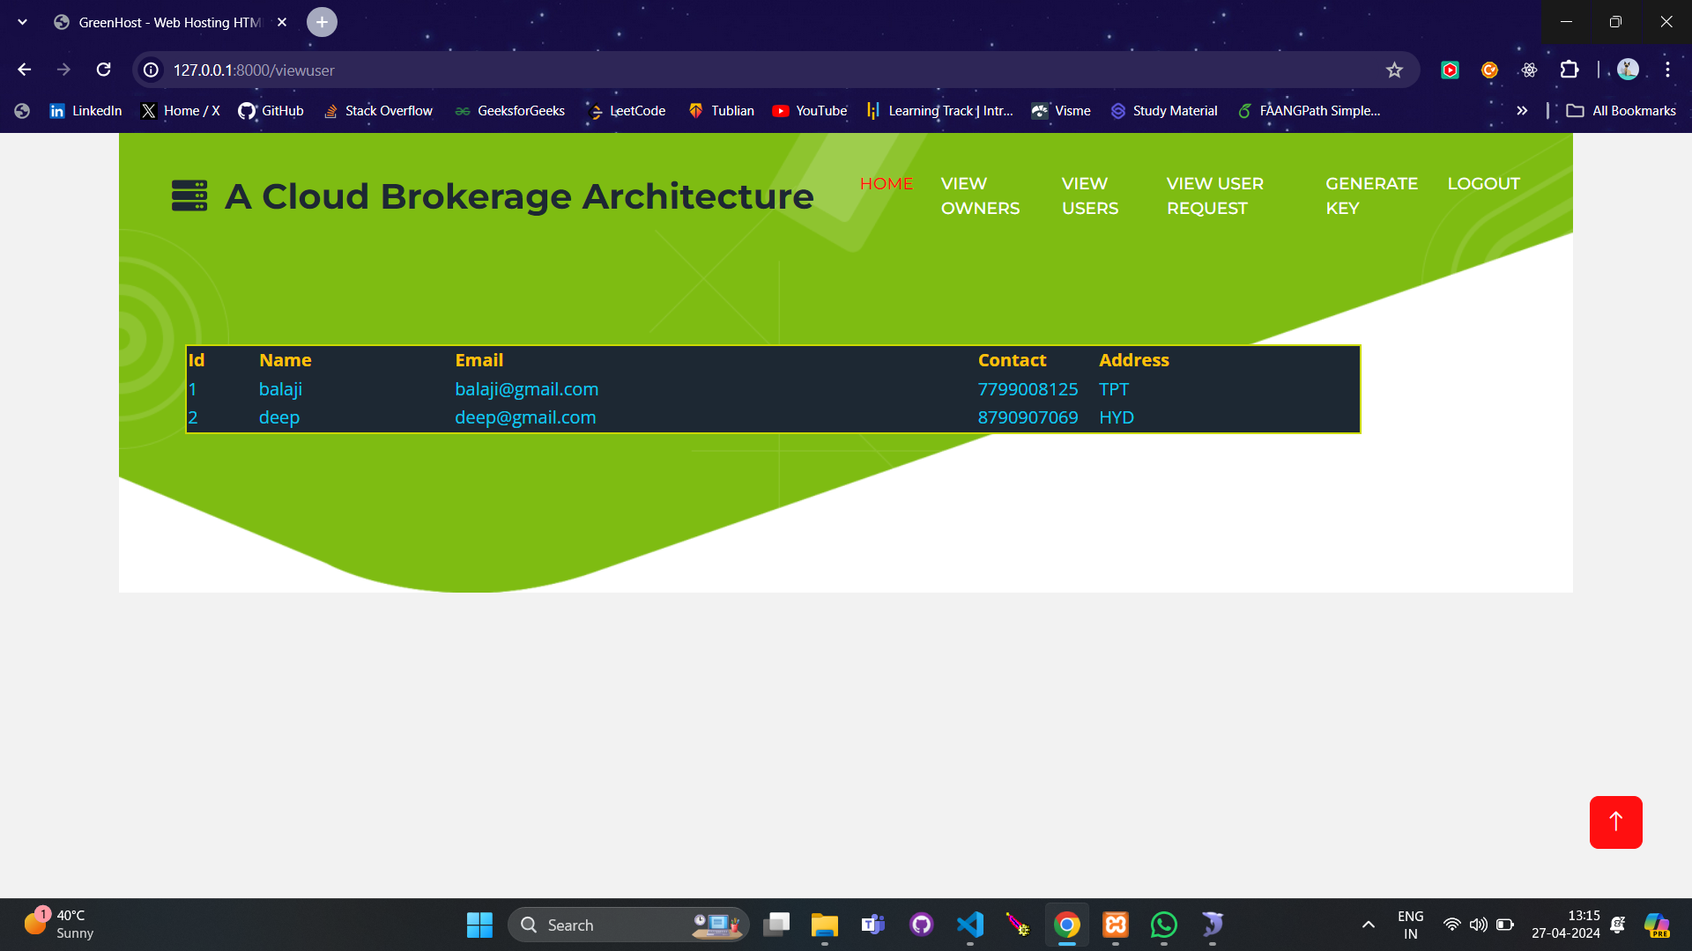
Viewing Data Users: Navigate to 'View Users' to observe a list of data users who are utilizing services on the cloud platform

Slide 28
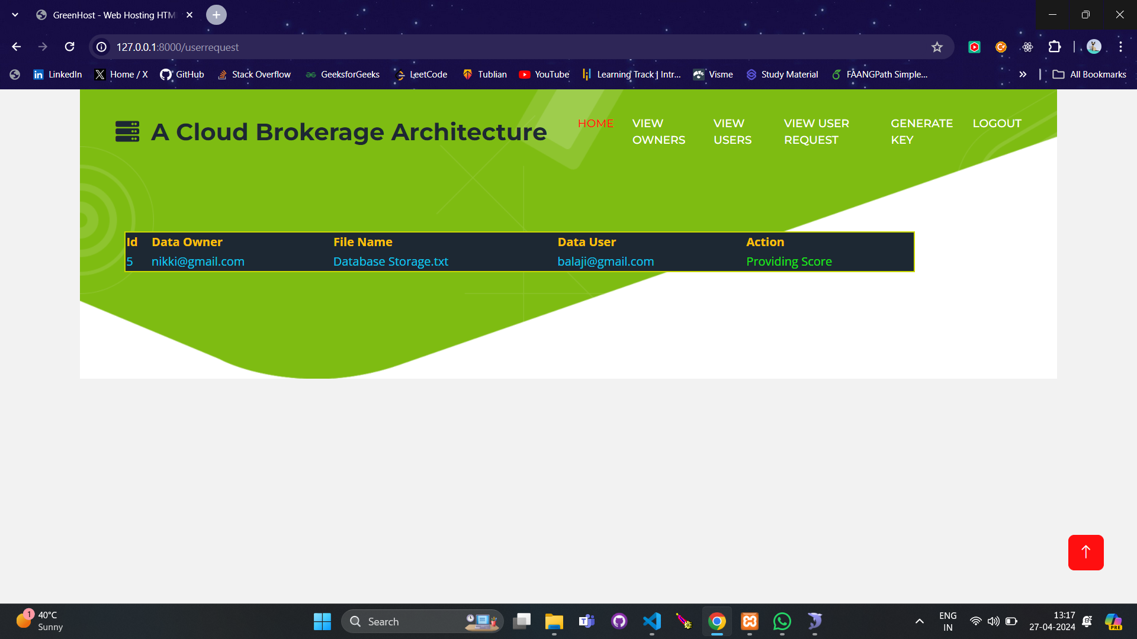
Scoring User Requests: Review and assign scores to user requests by selecting the 'View user request' feature.

Slide 29

Generating and Sending Keys: Click on 'Generate key' to create an encrypted key securely. Then, utilize the 'Send key' functionality to provide the generated key to data users for the purpose of secure file downloads.

Slide 30

User Home Page:

Slide 31

Viewing Available Files and Sending Access Requests: Use the 'Search/View file' option to see the list of available files. To request access or download, click on 'Send request'.

Slide 32
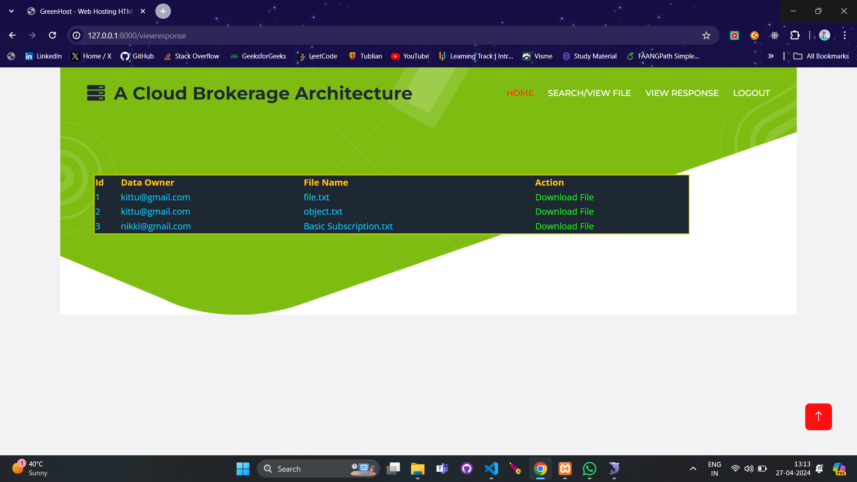
Viewing Granted Requests and Downloading Files: Check the status of your requests by clicking on 'View response'. Once your request is granted, you can download the file by clicking on the 'Download file' button.

Slide 33
CONCLUSION
In this paper, we presents a brokerage-based architecture for cloud computing systems, as well as an efficient cloud service selection algorithm that provides a list of recommended cloud service providers to the cloud consumers based on their needs. In particular, we designed a novel indexing structure, namely the Bcloud-tree, to facilitate the arrangement and retrieval of the information about service providers. On top of the Bcloud-tree, we further developed an efficient service selection query algorithm that quickly retrieves desired service providers based on the users’ service requests. Our experimental results show that the Bcloud-tree achieves significant improvement in terms of both efficiency and accuracy compared to our prior work. In the future, we plan to build an automated parser for extracting manifest variables of cloud service providers, and design strategies to provide the cloud users an opportunity to negotiate some terms of the service level agreements with the potential service providers.

Slide 34
REFERENCES
[1] Cloud-fuser: Fuzzy ontology and {MCDM} based cloud service selec- tion. Future Generation Computer Systems, 57:42–55, 2016.
[2] S. at TechTarget. Newservers: 2011 top cloud computing provider, 2011.
[3] M. B. and T. F. Decision-making in cloud computing environments: A cost and risk based approach. nformation Systems Frontiers, 14(4):87193, 2012.
[4] R. Buyya, C. Yeo, S. Venugopal, J. Broberg, and I. Brandic. Cloud computing and emerging it platforms: Vision, hype, and reality for delivering computing as the 5th utility. Future Generation computer systems, 25(6):599–616, 2009.
[5] C. W. Chang, P. Liu, and J. J. Wu. Probability-based cloud storage providers selection algorithms with maximum availability. In 41st International Conference on Parallel Processing, pages 199–208, 2012.
[6] CloudSwitch. http://www.cloudswitch.com/.
[7] M. Eggebrecht. Is cloud brokerage the next big thing? In http://www.ciozone.com/index.php/Cloud-Computing/Is-Cloud- Brokerage-the-Next-Big-Thingu.html.

Slide 35
[8] EQUINIX. http://www.equinix.com/industries/cloud-providers/.
[9] C. Esposito, M. Ficco, F. Palmieri, and A. Castiglione. Smart cloud storage service selection based on fuzzy logic, theory of evidence and game theory. IEEE Transactions on Computers, PP(99):1–1, 2015
[10] W.-J. Fan, S.-L. Yang, H. Perros, and J. Pei. A multi-dimensional trust- aware cloud service selection mechanism based on evidential reasoning approach. International Journal of Automation and Computing, 12(2):208–219, 2014.
[11] N. Ghosh, S. K. Ghosh, and S. K. Das. Selcsp: A framework to facilitate selection of cloud service providers. IEEE Transactions on Cloud Computing, 3(1):66–79, 2015.
[12] S.-M. Han, M. M. Hassan, C.-W. Yoon, and E.-N. Huh. Efficient service recommendation system for cloud computing market. In Proceedings of the 2nd International Conference on Interaction Sciences: Information Technology, Culture and Human, pages 839–845, 2009.
[13] J. Hartigan and M. A. Wong. Algorithm as 136: A k-means clustering algorithm. Journal of the Royal Statistical Society. Series C (Applied Statistics), 28:100–108, 1979.
[14] Q. He, J. Han, Y. Yang, J. Grundy, and H. Jin. Qos-driven service selection for multi-tenant saas. In IEEE 5th International Conference on Cloud Computing (CLOUD), pages 566–573, 2012.

